Slide 1
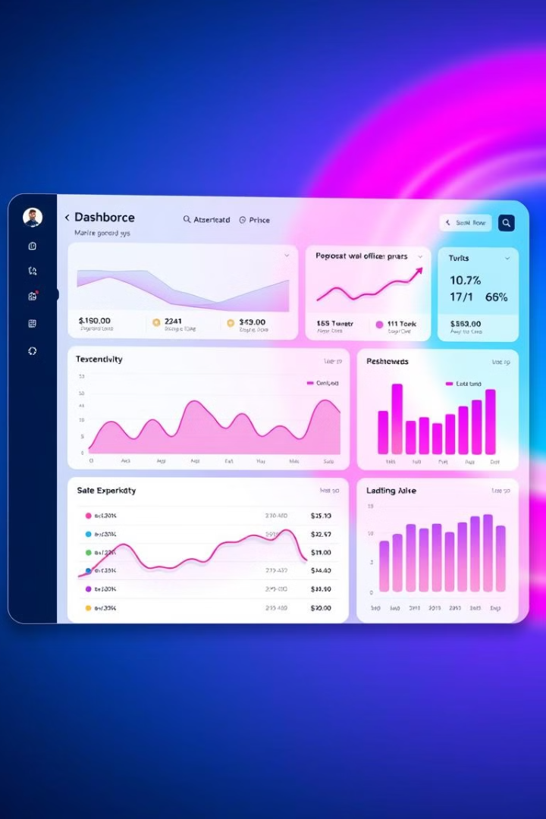
JAI E-Commerce Sales Dashboard: Power BI Project
This project focuses on creating an interactive Power BI dashboard. It visualizes e-commerce sales data to identify trends. Ultimately, it seeks to improve decision-making. Real-time visibility is key. The data source is the e-commerce platform sales data.
By : Jaiwardhen Rathore

Slide 2
Problem: Inefficient Sales Analysis
The current process involves manual report generation. Spreadsheet-based analysis is time-consuming. It is also prone to errors. Delayed insights hinder proactive strategies.
The goal is to automate sales analysis with Power BI. Reduce report generation time by 75%. Improve accuracy and enable data-driven decisions.

Slide 3




Data Sources
Extract
Pull data from Shopify API using Power BI connectors.
Transform
Clean, format, and merge tables.
Load
Load the transformed data into the Power BI data model.

Slide 4





Key Performance Indicators (KPIs)
Sales Revenue
Conversion Rate
Average Order Value
Target: 15% increase in monthly sales revenue.
Target: Increase from 2% to 3%.
Target: 10% increase through upselling.
Customer Lifetime Value
Target: 25% increase by improving retention.

Slide 5
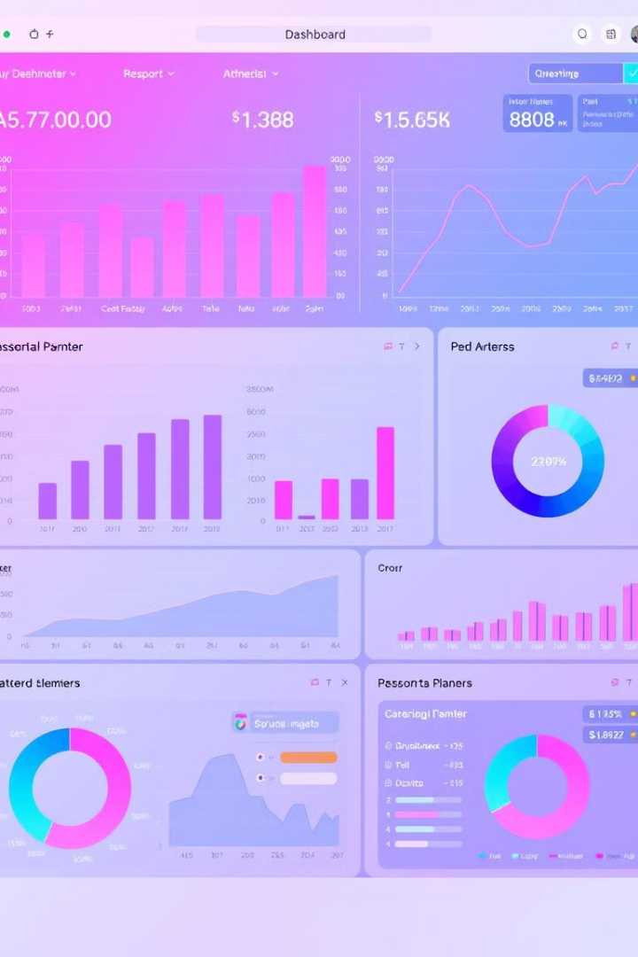
Dashboard Design & Visualizations
Sales Overview
Customer Analysis
Total Revenue
Customer Segmentation
Revenue Trend
New vs. Returning Customers
Sales by Product Category
Geographic Sales
Sales by Region

Slide 6

Advanced Analytics & Insights
Cohort Analysis
1
Analyze customer behavior over time.
2
RFM Analysis
Segment customers based on recency, frequency, and monetary value.
Sales Forecasting
3
Predict future sales using time series analysis.

Slide 7
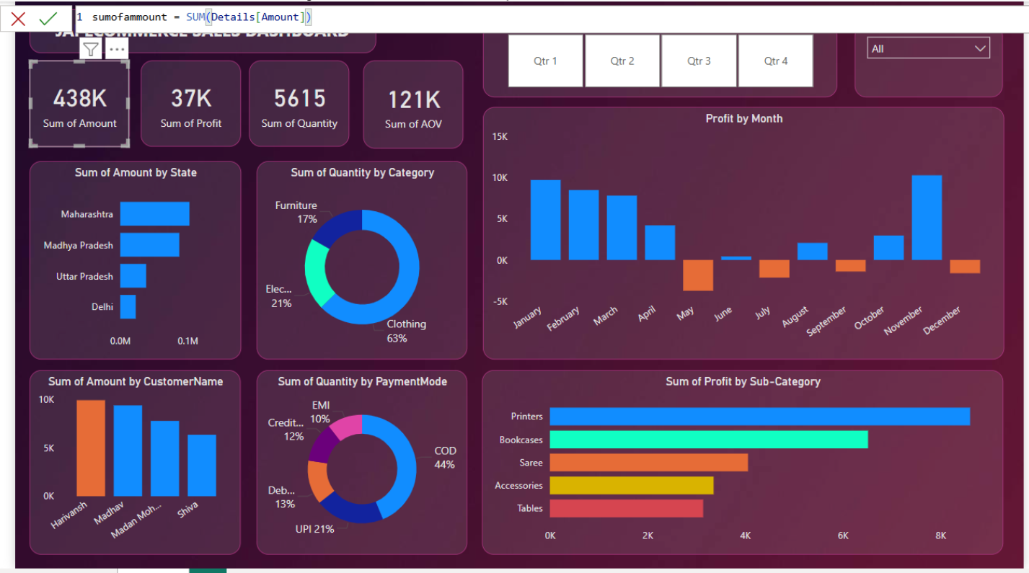
Que : How to find the sum of amount of sales dashboard ?
Ans.

Slide 8
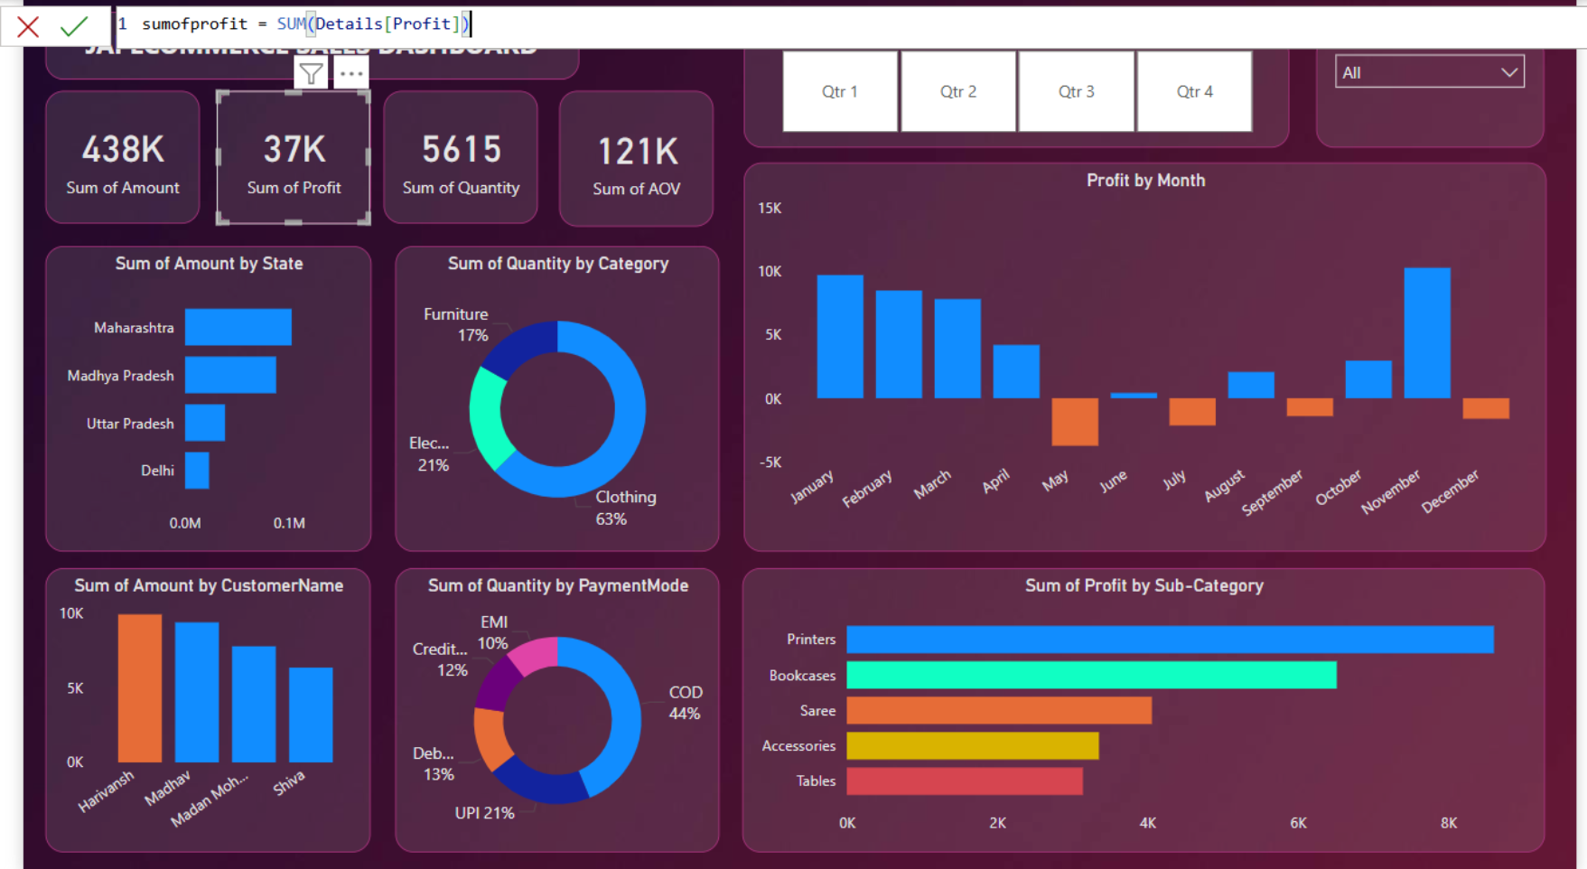
Que : How to find the sum of profit of sales dashboard ?
Ans.

Slide 9

Que : How to find the sum of quantity of sales dashboard ?
Ans.

Slide 10
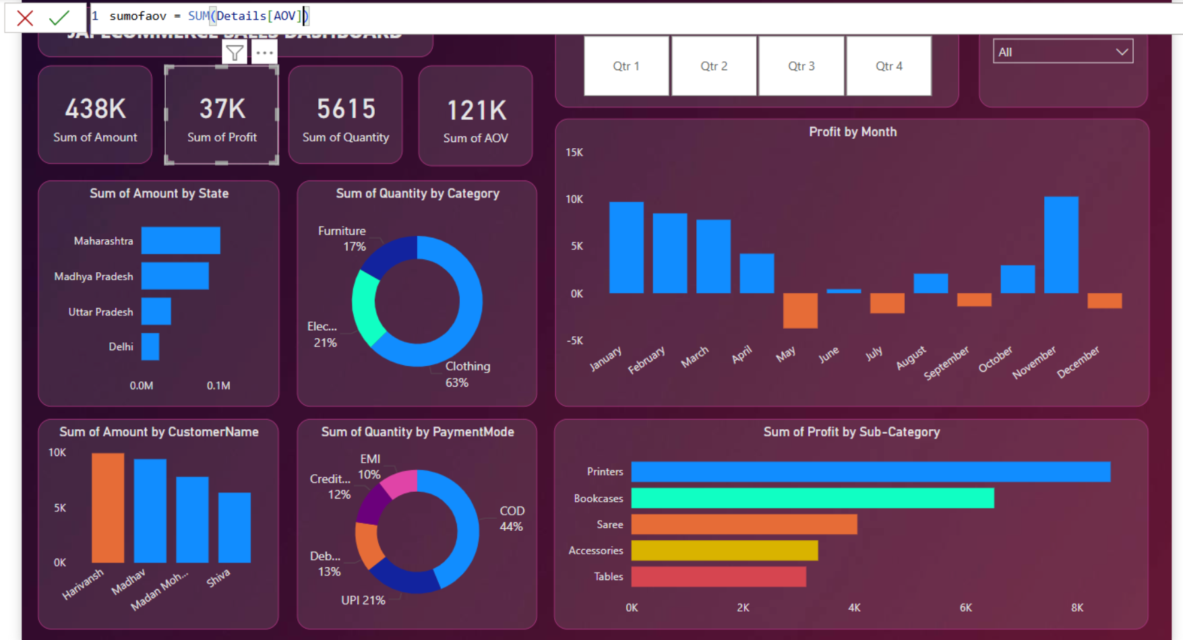
Que : How to find the sum of profit of sales dashboard ?
Ans.

Slide 11


